Slide 1
TV Manager UI Specification (webOS 23)
Modified Date : 02/10/2023
Document Version : 0.2

Slide 2
Document History
Version | Date | Description | Writer | Remark
0.1 | 02/01/2023 | TV Manger webOS 23 version based on TV Manger webOS 22 | Jonghyun
0.2 | 02/10/2023 | Wrong image changed. (p44) | Jonghyun

Slide 3
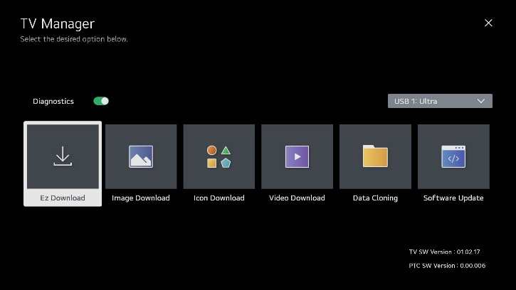
Overall Flowchart
Insert USB
Check OTA ID
??
OTA ID is not matched.
Display pop-up window
for downloading new version
OTA ID is matched.
Higher EPK version exists?
End
Yes
1
No
No
DZM file exists?
Yes
General
(setup menus)
Safety
(Function Menu)
Automatically display
TV Manager / Ez Download screen
2
Press 7777777 on remote
Check the files in the last applied DZM file
DZM file exists?
TV Manager
Yes
Ez Download screen
No
Select files
Update or create DZM file
Display “None”
Apply files
Downloading files

Slide 4
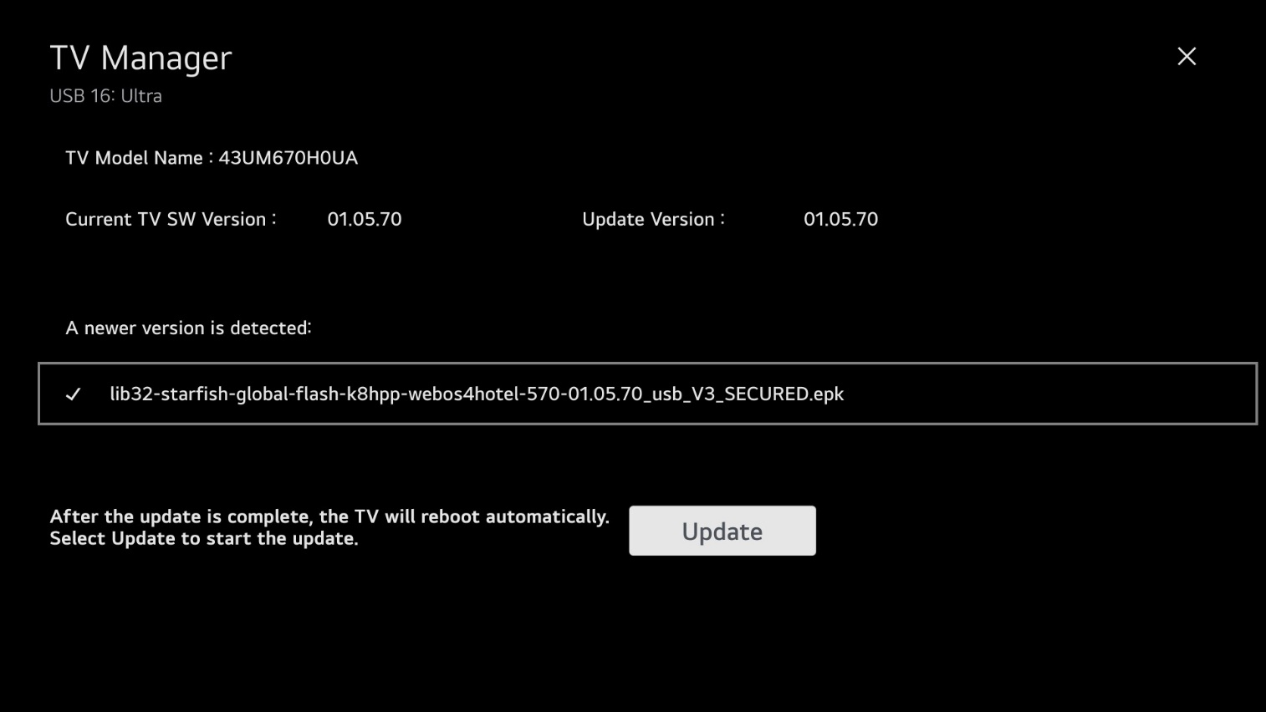
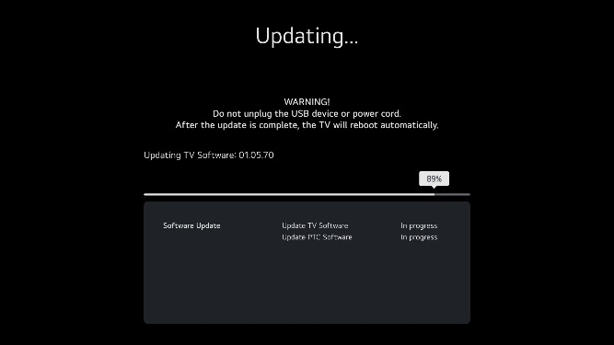
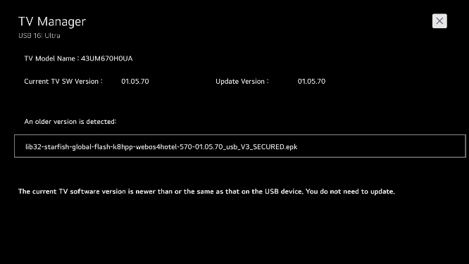
1. UI specification (TV Manager – Automatic TV Software Update [No DZM file])
Other remarks
Automatically reboot after the update is complete.
Screen
Explanation
Update Button: Start software update.
ⓧ Button: Exit TV Manager.
Default focus: Update Button
If the software version on the USB device is equal to or lower than the version currently installed on the TV, it cannot be updated.
Further
Operation
The version of the EPK should be higher than that of the TV.
If DZM exists, Ez Download screen will be displayed instead of auto Update TV Software screen.

Slide 5

1. UI specification (TV Manager – Overview_1)
Other remarks
TV Manager / USB download options enable users to download software, media, and configuration files from a USB memory device to a TV.
1. Software (CPU and PTC), media files, and Pro:Idiom M Key files should be placed in an “\LG_DTV” or “\lg_dtv” folder. Clone (configuration) files should be placed in the root directory of the USB device.
2. File types:
-- Logo Image files: jpeg, jpg, bmp
-- Background/Hotel Directory Image/Icon files: jpeg, jpg, png
-- Video files: avi, mkv, mp4, 3gp, 3g2, ts, tp, trp, mpg, mpeg, vob, vro, asf, wmv, mov, dat, f4v, flv, tts, m4v, k3g, m2ts, mpe, mts, webm, lge, lg2, lgv -- Clone files: tlx -- Pro:Idiom M Key files: pim
-- Software update files: epk (CPU) (check whether OTA ID is matched) / txt (PTC) (check whether PTC model name is matched)
3. If DZM file exists, previously downloaded file(s) will be selected for Ez Download.
4. If the USB device with DZM file is still connected to the TV after updates are complete, the Ez Download screen with previously selected files will be redisplayed.
Press MENU SETTINGS on remote, and select/highlight either General menu icon from TV setup menus or Safety menu icon from Function Menu. Then, press number “7” key a total of seven times (7777777) to access the TV Manager.
If the user selects a USB download option and there are no files on the USB device or a USB device is not currently inserted, a pop-up banner is displayed with a prompt to insert a USB device (see example on next page). Select OK button to dismiss pop-up.
Screen
Explanation
Further
Operation
The Ez Download utility enables users to download multiple items all at once, e.g., TV (CPU), PTC, TLX, Image, Icon, Video, Pro:Idiom M Key files. Other TV Manager options allow the user to update one file type.
Download order is: Image -> Icon -> Video -> Pro:Idiom M Key -> Clone file -> TV (CPU) software -> PTC software

Slide 6
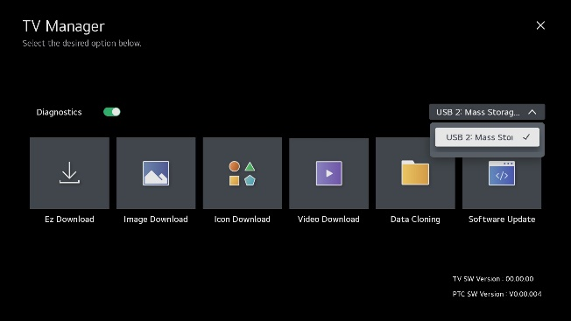
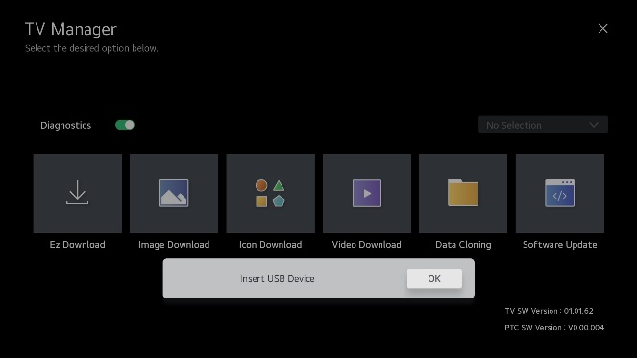
1. UI specification (TV Manager – Overview_2)
Other remarks
If there is no action during 40 sec, the app will be closed.
.
If there is more than one USB memory device, it is possible to select the USB device.
.
Diagnostics: Sets status On (enabled) or Off (disabled). When it is set to Off, user can't control TV via RMS. The changed setting is applied after reboot.
USB Device: Select USB device (default USB device is selected in order mounted).
ⓧ Button: Exit TV Manager.
Default focus: Ez Download.
Button
Operation
Right Key: Move Image Download.
Up Key: Move to Diagnostics.
Diagnostics toggle: Press OK (Enter) on remote to toggle.
An “Insert USB Device” pop-up is displayed if you attempt to select a TV Manager download/update option without a USB connection or if there are no files on the USB device.
Further
Operation

Slide 7
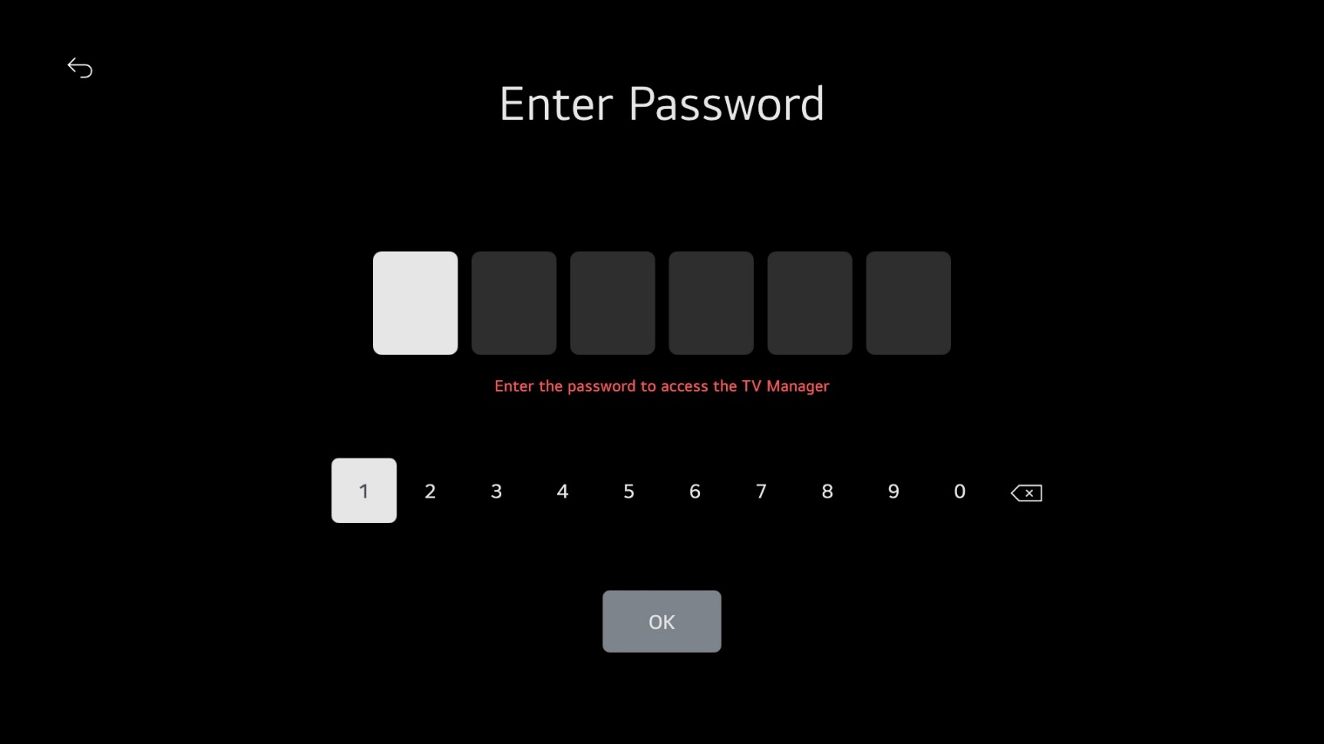

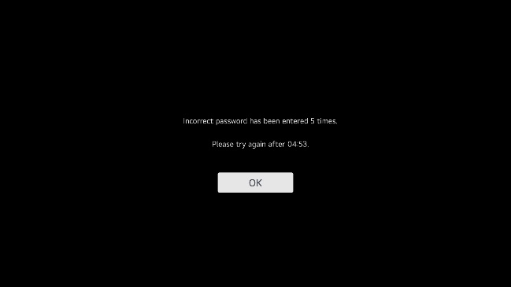

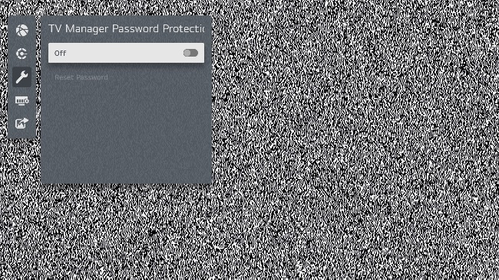
1. UI specification (TV Manager Password Protection)
Other remarks
.
If the password is incorrect, the message changes.
title: ‘Check Password',
message: 'Incorrect password(N/5). Please enter correct password.’
.
Button
Operation
Numeric keys: Enter password number.
: Delete password number
Button: Exit TV Manager.
OK: Enter password.
If you make a mistake with password 5, you will not be able to enter your password in TV Manager for 5 minutes.
Further
Operation
If the password is wrong five times, the TV Manager will be forced to exit.
The password can be set in the IP Environment Menu: General > Security > TV Manager Password Protection.
The number of password attempts has been changed from three to five. Also, if you get it wrong 5 times, you cannot enter the password for 5 minutes when entering the TV Manager.
This does not apply to the (p4) scene where only EPK is updated alone.
The password can be set in the IP Environment Menu.

Slide 8
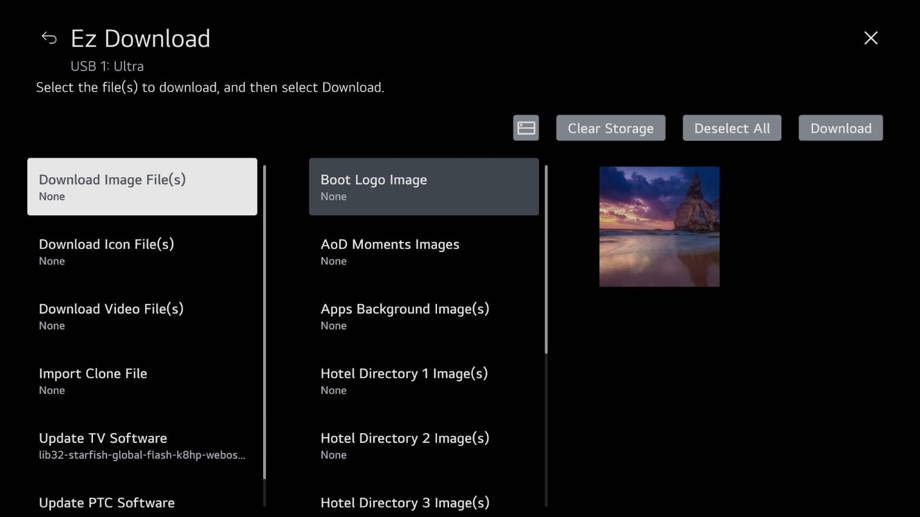
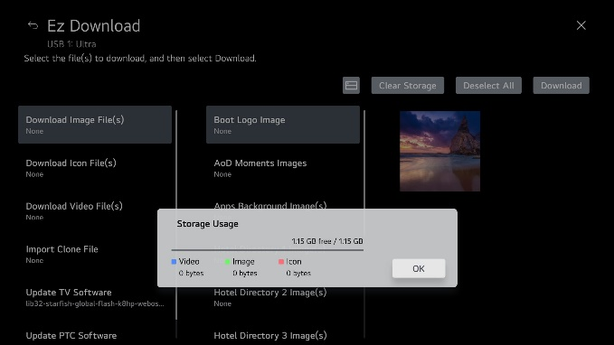

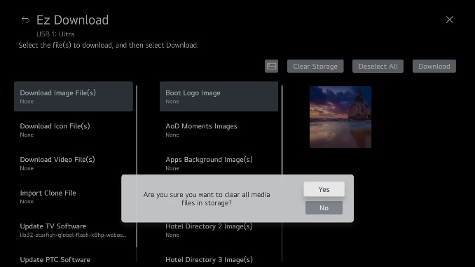
1. UI specification (Ez Download – Overview)
Other remarks
Download Image File(s) includes Boot Logo Image, Apps Background Image(s), Hotel Directory Image(s).
Download Icon File(s) includes Hotel Icon on Portal and Website Shortcuts.
Displays the number of files selected at the bottom of Download Image File(s) and Download Icon File(s).
Displays the name of the selected file under Import Clone File, Download Pro:Idiom M Key (if applicable), Update TV Software, and Update PTC Software.
ⓧ : Exit TV Manager.
Deselect All: Returns to the previous state of selection.
Download: Start Download.
Default focus: “Download” when DZM exists, "Import Clone File" when DZM does not exist.
(Storage): Shows the capacity of the downloaded media files and the available capacity.
Clear Storage: Delete all media files.
Screen
Explanation
Further
Operation
Down Key : Move to Download Icon File(s) option.
Right Key: Move to file area.
Up Key: Move to Storage button.
Back Key: Return to the previous page (TV Manager main screen).

Slide 9

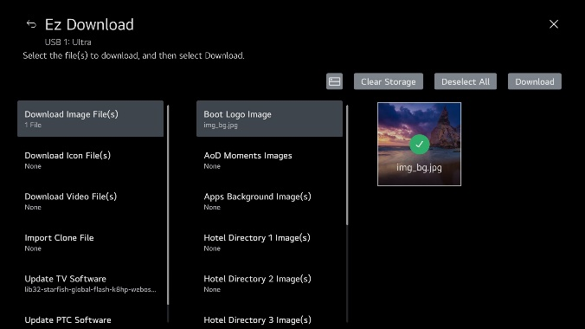
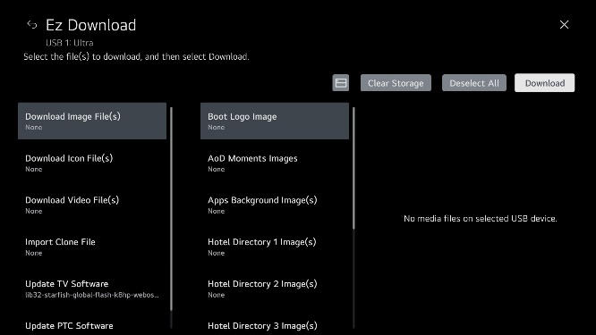
1. UI specification (Ez Download – Download Image File[s])
Other remarks
When you select image, image is checked.
(To unselect image, press OK [Enter] again.)
Download Image File(s): Show Boot Logo Image, Apps Background Image(s), and Hotel Directory Image(s) options.
Boot Logo image: Only one image can be selected. .
Apps Background and Hotel Directory images: Up to 12 images or up to 10 MB can be selected (for each field).
Image area: Show images in USB device \LG_DTV or \lg_dtv folder.
Button
Operation
If there are no image files, the screen will show: “No media files on selected USB device.”
When download is complete, the TV will automatically reboot.
Further
Operation
Back Key: Return to the previous page (TV Manager main screen).
Right Key: Move to image area.
3. Up/Down Key: Move to “Storage” or “Download Icon File(s).”
4. Image area: Use arrow keys to navigate between images. Press OK (Enter) on remote to select image.

Slide 10
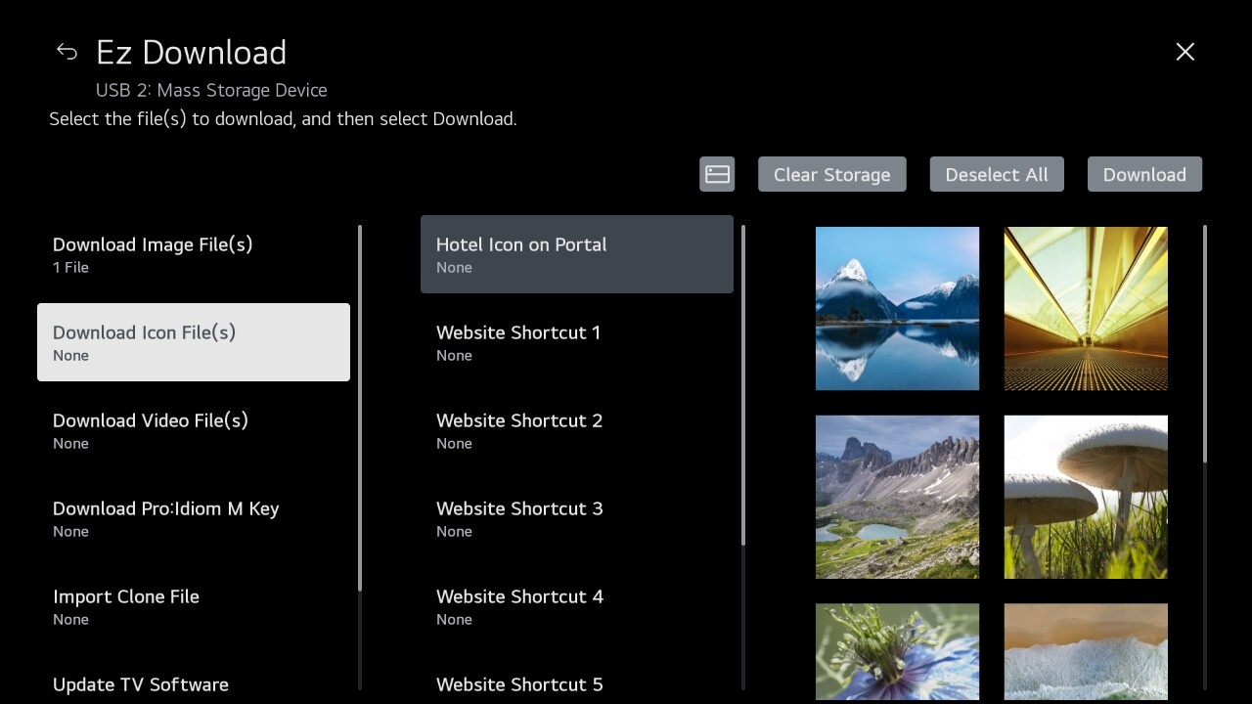
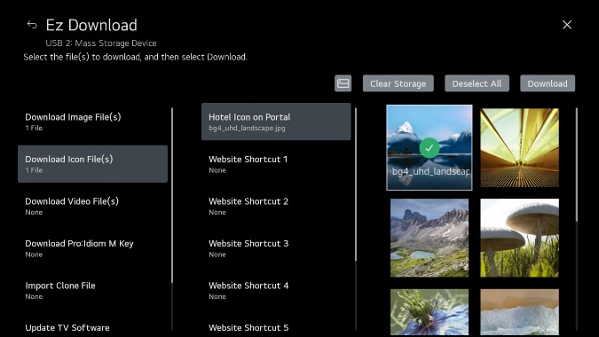
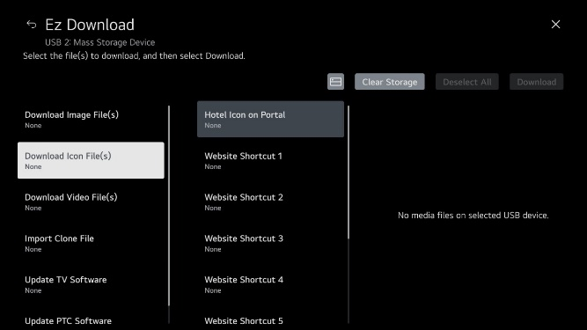
1. UI specification (Ez Download – Download Icon File[s])
Other remarks
When you select image, image is checked.
(To unselect image, press OK [Enter] again.)
Button
Operation
Download Icon File(s): Show Hotel Icon on Portal and Website Shortcut and Input Shortcut image options. Only one image can be selected in each field.
2. Image area: Show images in USB device \LG_DTV or \lg_dtv folder.
Back Key: Return to the previous page (TV Manager main screen).
Right Key: Move to icon image area.
Up/Down Key: Move to “Download Image File(s)” or “Download Video File(s).”
Image area: Use arrow keys to navigate between images. Press OK (Enter) on remote to select image.
If there no icon image files, the screen will show: “No media files on selected USB device.”
When download is complete, the TV will automatically reboot.
Further
Operation

Slide 11
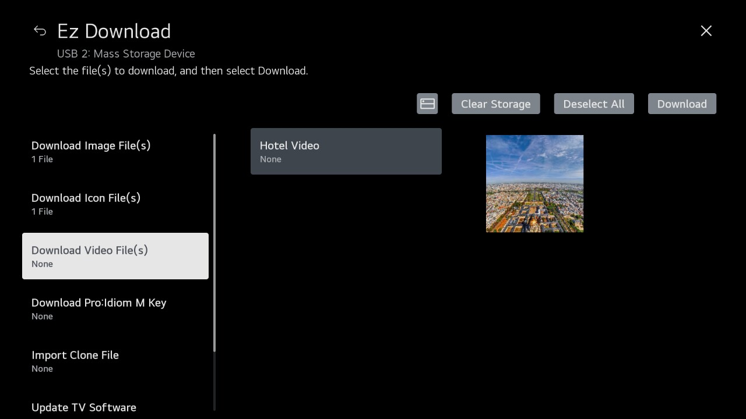
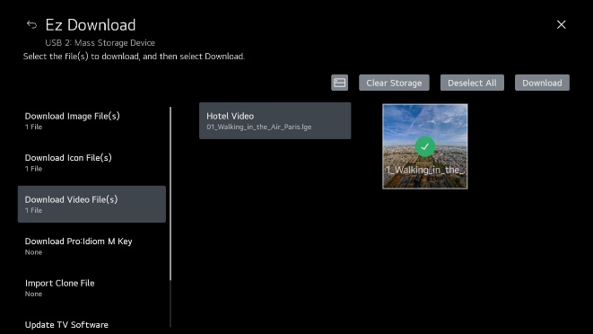
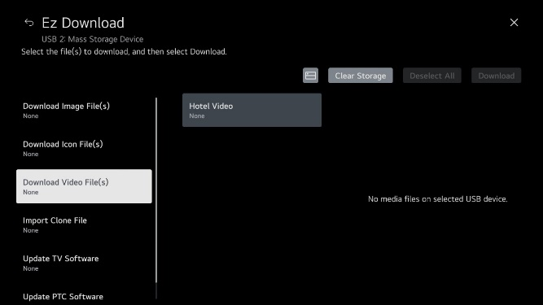
1. UI specification (Ez Download – Download Video File(s))
Other remarks
When you select image, video file is checked.
(To unselect image, press OK [Enter] again.)
Button
Operation
Download Video File(s): Show Welcome Video and Hotel Video options. Only one image can be selected in each field.
2. Image area: Show video files in USB device \LG_DTV or \lg_dtv folder.
Back Key: Return to the previous page (TV Manager main screen).
Right Key: Move to image area.
Up/Down Key: Move to “Download Icon File(s)” or “Update TV Software” (or “Download Pro:Idiom M Key” if .pim file is present).
Image area: Use arrow keys to navigate between images. Press OK (Enter) on remote to select video.
If there are no video files, the screen will show: “No media files on selected USB device.”
When download is complete, the TV will automatically reboot.
Further
Operation

Slide 12
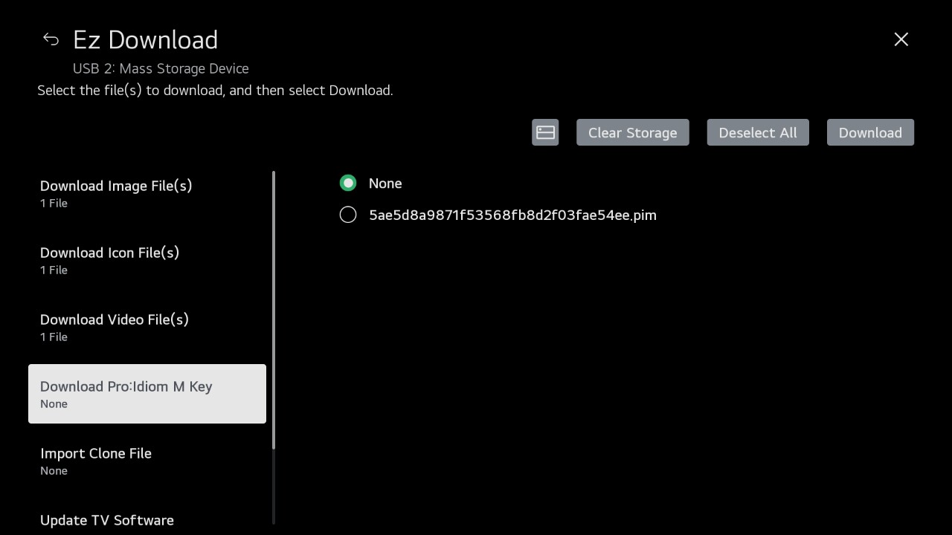
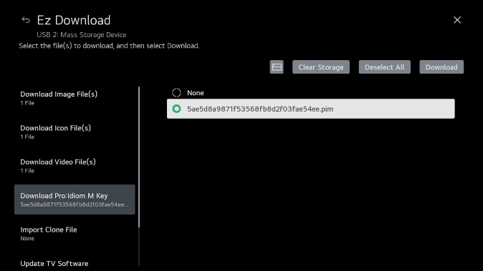
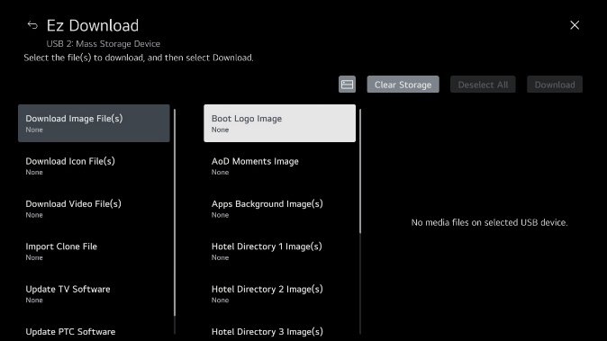
1. UI specification (Ez Download – Download Pro:Idiom M Key)
Other remarks
You can select “None” or “.pim” file. When you select “None,” TV is not updated.
Button
Operation
1. Download Pro:Idiom M Key: Show selected file name.
2. File area: Show .pim files in USB device \LG_DTV or \lg_dtv folder.
Back Key: Return to the previous page (TV Manager main screen).
Right Key: Move to file area.
Up/Down Key: Move to “Download Video File(s)” or “Import Clone File.”
File area: Use arrow keys to navigate between files. Press OK (Enter) on remote to select file.
When download is complete, the TV will automatically reboot.
If there are no .pim files in USB device \LG_DTV or \lg_dtv folder, “Download Pro:Idiom M Key” does not show in Ez Download options.
Further
Operation

Slide 13
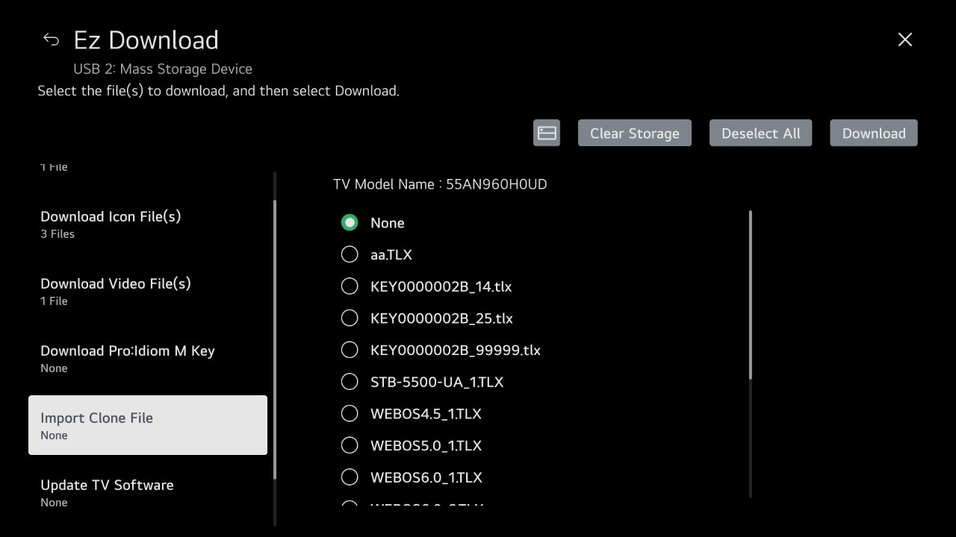
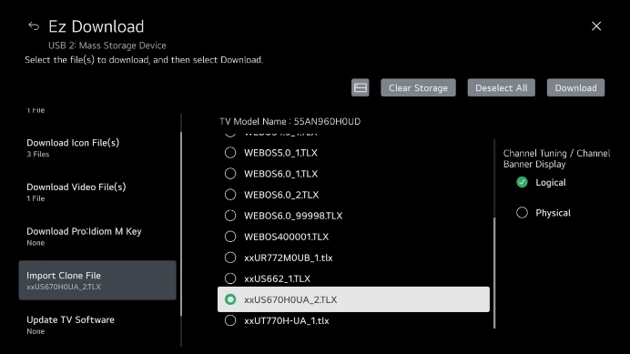
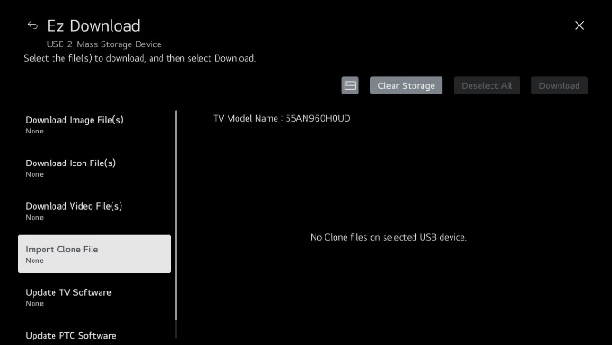
1. UI specification (Ez Download – Import Clone File)
Other remarks
You can select “None” or “.tlx” (Clone) file. When you select “None,” the TV configuration is not updated.
1. Import Clone File: Show selected file name.
2. File area: Show .tlx files in root folder of USB device.
3. If file has Channel Map (with RF channels and Aux inputs only), you can select “Logical” or “Physical” channel tuning (see example at right).
If file has no Channel Map, “No Channel Map in Clone file!!” is displayed.
Button
Operation
Further
Operation
Back Key: Return to the previous page (TV Manager main screen).
Right Key: Move to TLX list.
Up/Down Key: Move to “Storage” or “Download Image File(s).”
File area: Use the arrow keys to navigate between files and Channel Tuning / Channel Banner Display field (as applicable). Press OK (Enter) on remote to select file/tuning options.
When download is complete, the TV will automatically reboot.
If there are no Clone files, the screen will show: “No Clone files on selected USB device.”

Slide 14
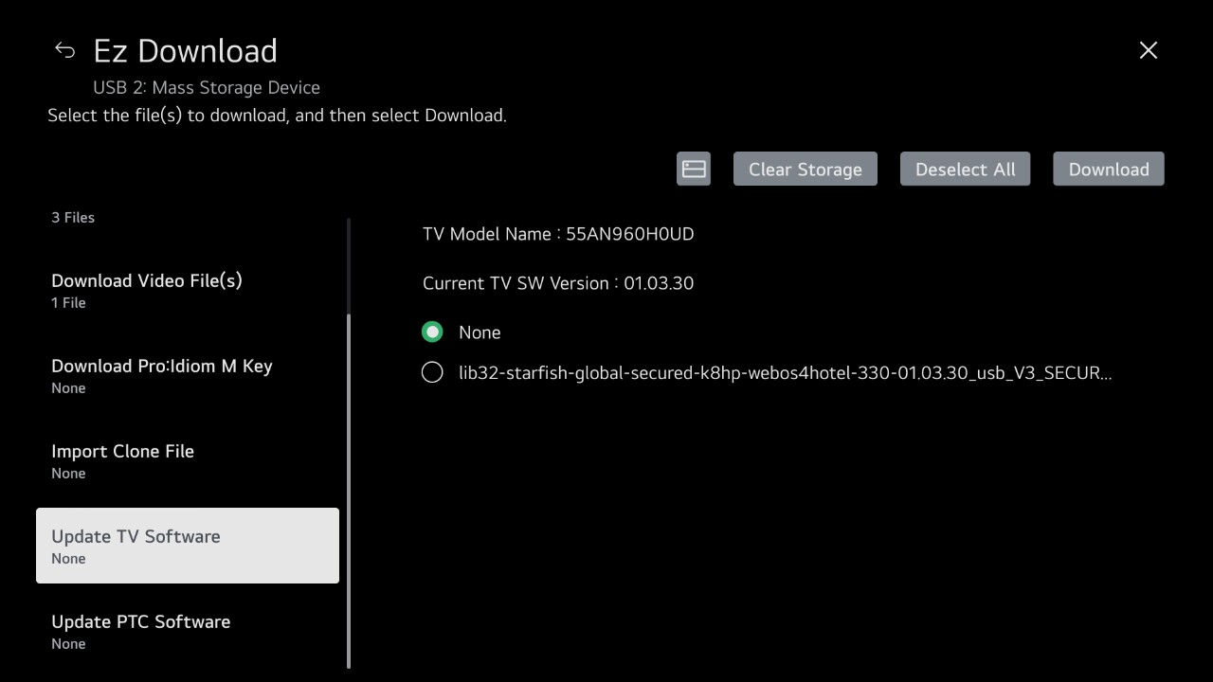
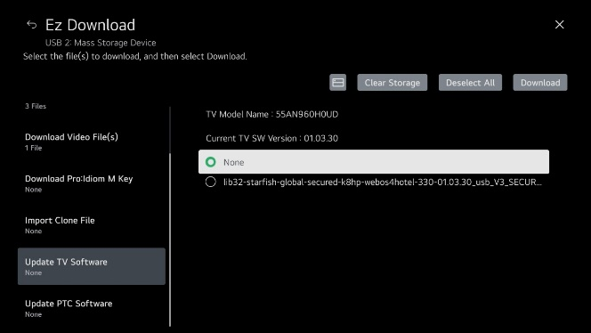
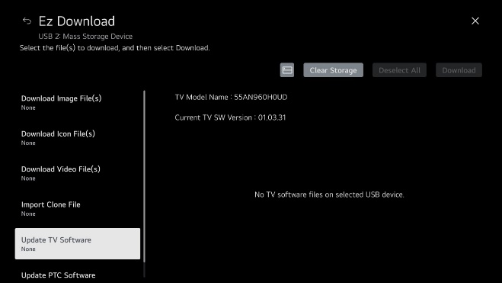
1. UI specification (Ez Download – Update TV Software)
Other remarks
You can select “None” or “.epk” file. When you select “None,” TV (CPU) software is not updated.
Button
Operation
1. Update TV Software: Show selected file name.
2. File area: Show .epk files in USB device \LG_DTV or \lg_dtv folder.
Back Key: Return to the previous page (TV Manager main screen).
Right Key: Move to file area.
3. Up/Down Key: Move to “Download Video File(s)” (or “Download Pro:Idiom M Key” if .pim file is present) or “Update PTC Software.”
4. File area: Use arrow keys to navigate between files. Press OK (Enter) on remote to select file.
When download is complete, the TV will automatically reboot.
If there are no TV software files, the screen will show: “No TV software files on selected USB device.”
Further
Operation

Slide 15
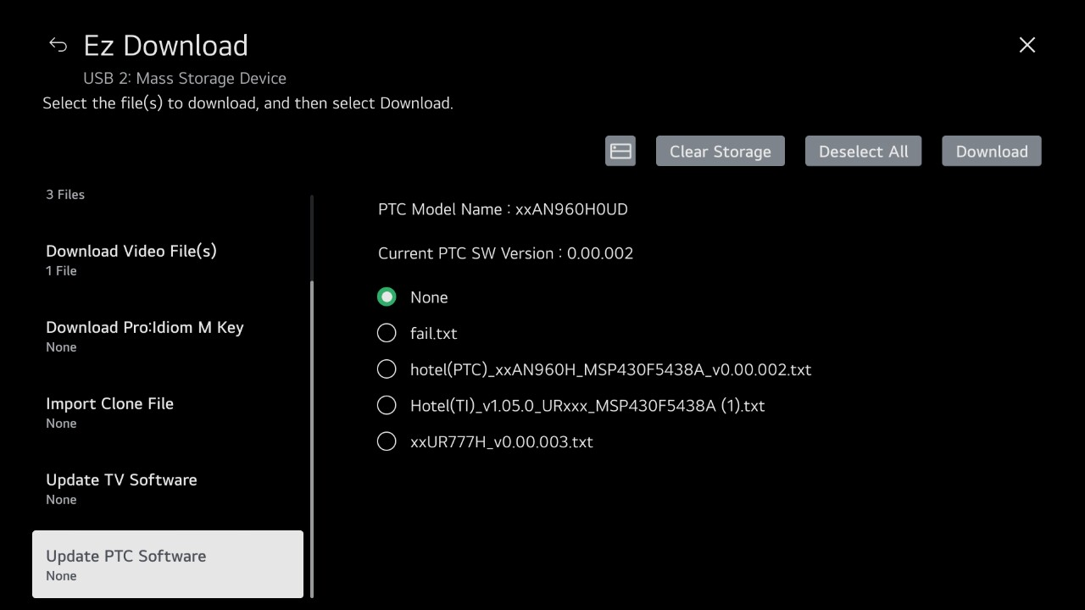
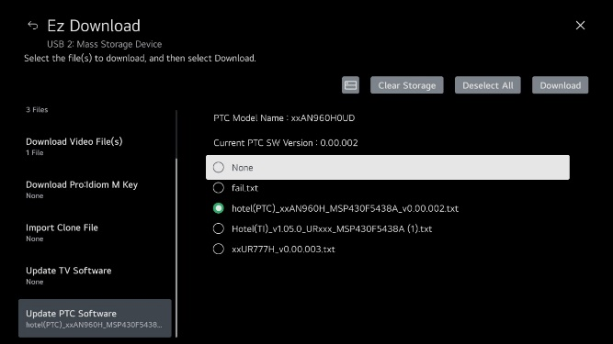
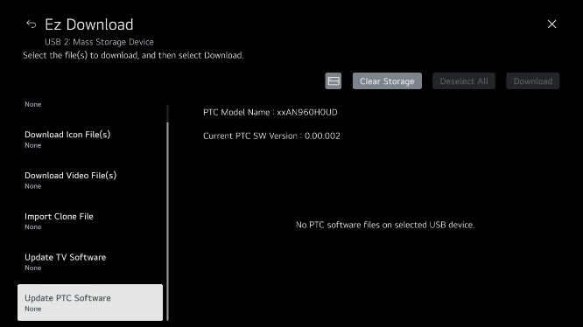
1. UI specification (Ez Download – Update PTC Software)
Other remarks
You can select “None” or “.txt” file. When you select “None,” PTC software is not updated.
Button
Operation
1. Update PTC Software: Show selected file name.
2. File area: Show .txt files in USB device \LG_DTV or \lg_dtv folder.
When download is complete, the TV will automatically reboot.
If there are no PTC software files, the screen will show: “No PTC software files on selected USB device.”
Further
Operation
Back Key: Return to the previous page (TV Manager main screen).
Right Key: Move to file area.
3. Up Key: Move to “Update TV software.”
4. File area: Use arrow keys to navigate between files. Press OK (Enter) on remote to select file.

Slide 16
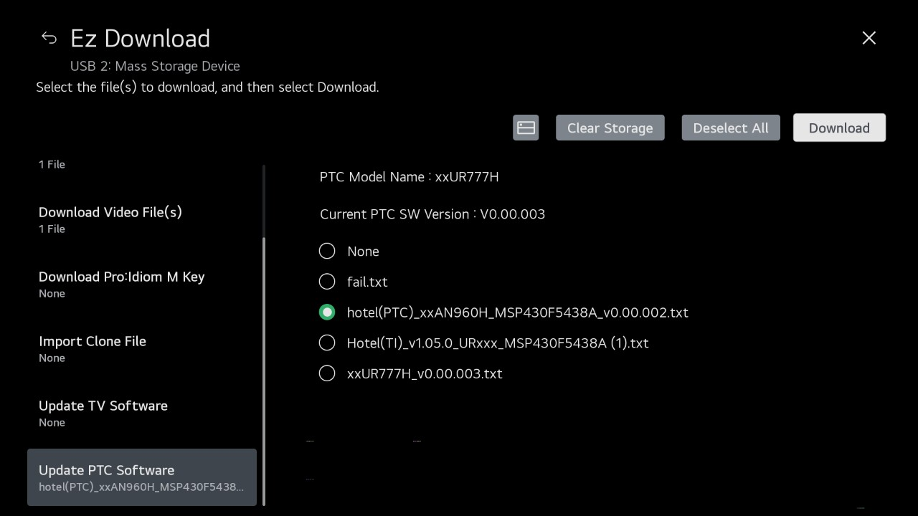
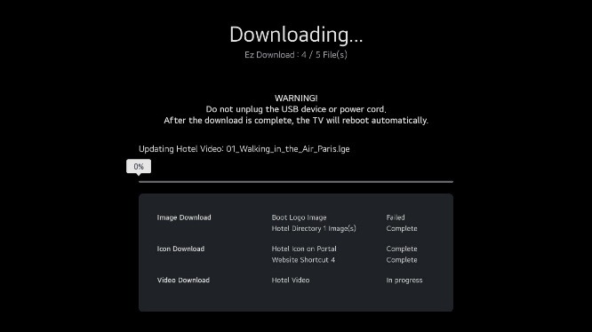
1. UI specification (Ez Download – Download/Update)
Other remarks
You can view update in real time.
1. Download Button: Select to initiate downloads/updates with the files you selected. For file types where no file (i.e., “None”) has been selected, there is no download/update. When you select Download, panel is changed to real time progress screen.
Button
Operation
Further
Operation
All keys are not working while downloading.

Slide 17
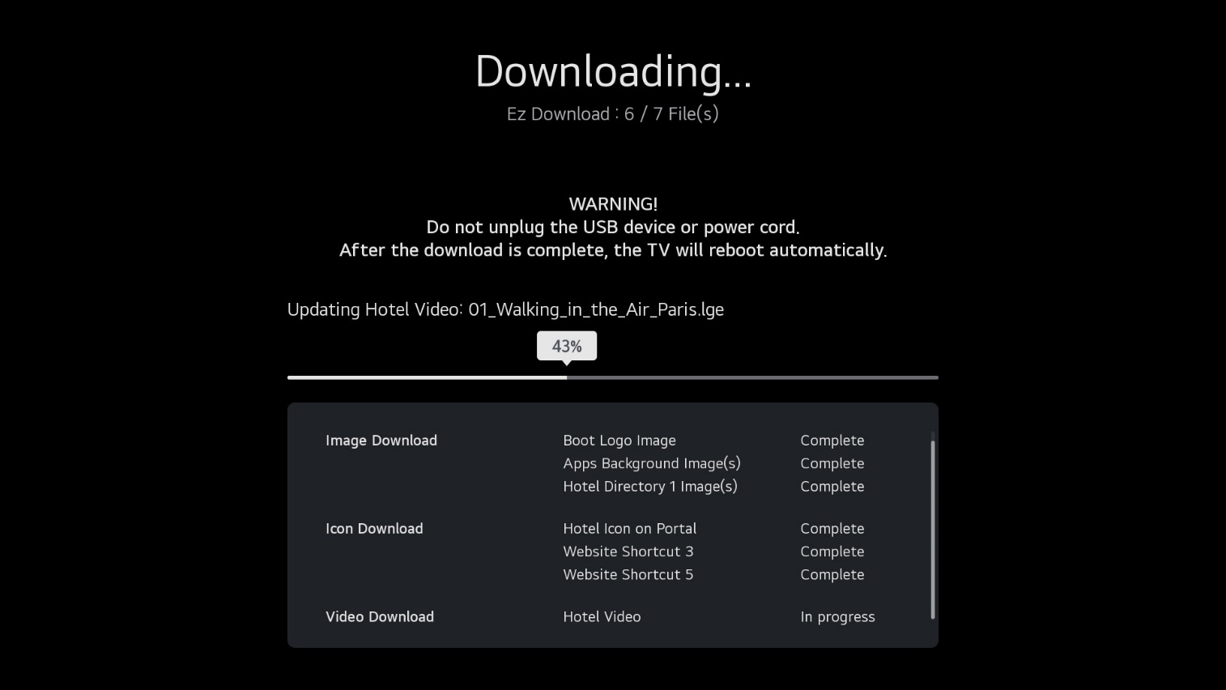
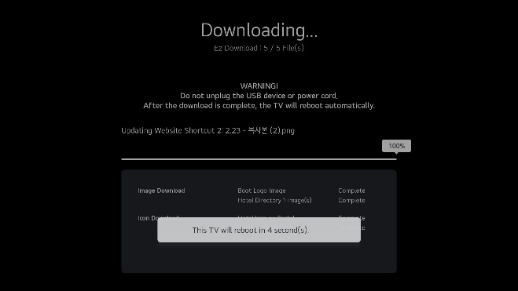
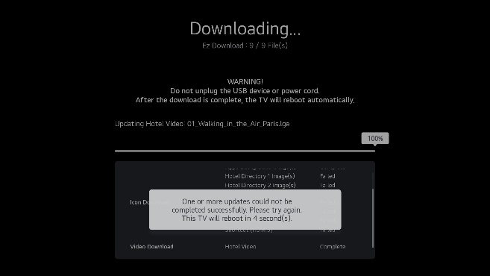
1. UI specification (Ez Download – Download/Update Successful/Complete)
Other remarks
This TV will reboot in 5 second(s).
Screen
Explanation
Successful update is applied when TV is rebooted.
the TV will reboot 5 seconds after the last file is downloaded.
If the Ez Download contains a PTC update, TV is reboot focused.
If one or more (but not all) of the updates fails, the pop-up banner indicates: “One or more updates could not be completed successfully. Please try again. The TV will reboot in 5 seconds ”
Further
Operation

Slide 18
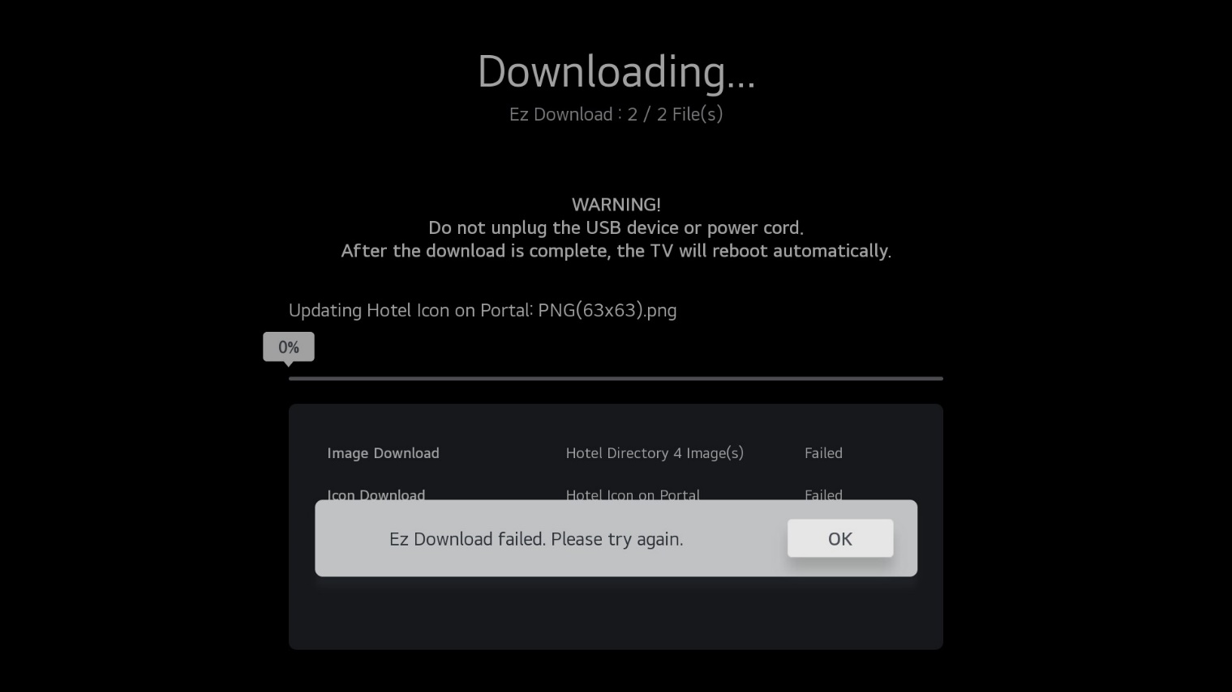
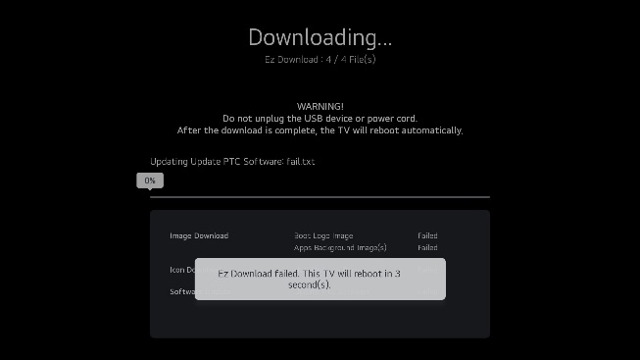
1. UI specification (Ez Download – Update Failure)
Other remarks
If the Ez Download includes a PTC update, the TV will reboot regardless of download success.
Button
Operation
Further
Operation
If all files fail the update, status pop-up message is displayed on the screen. Select OK button to return to the Ez Download screen (see PTC exception at right), the TV does not reboot. You can try again.
The time-out does not apply when a failed pop-up is output.

Slide 19
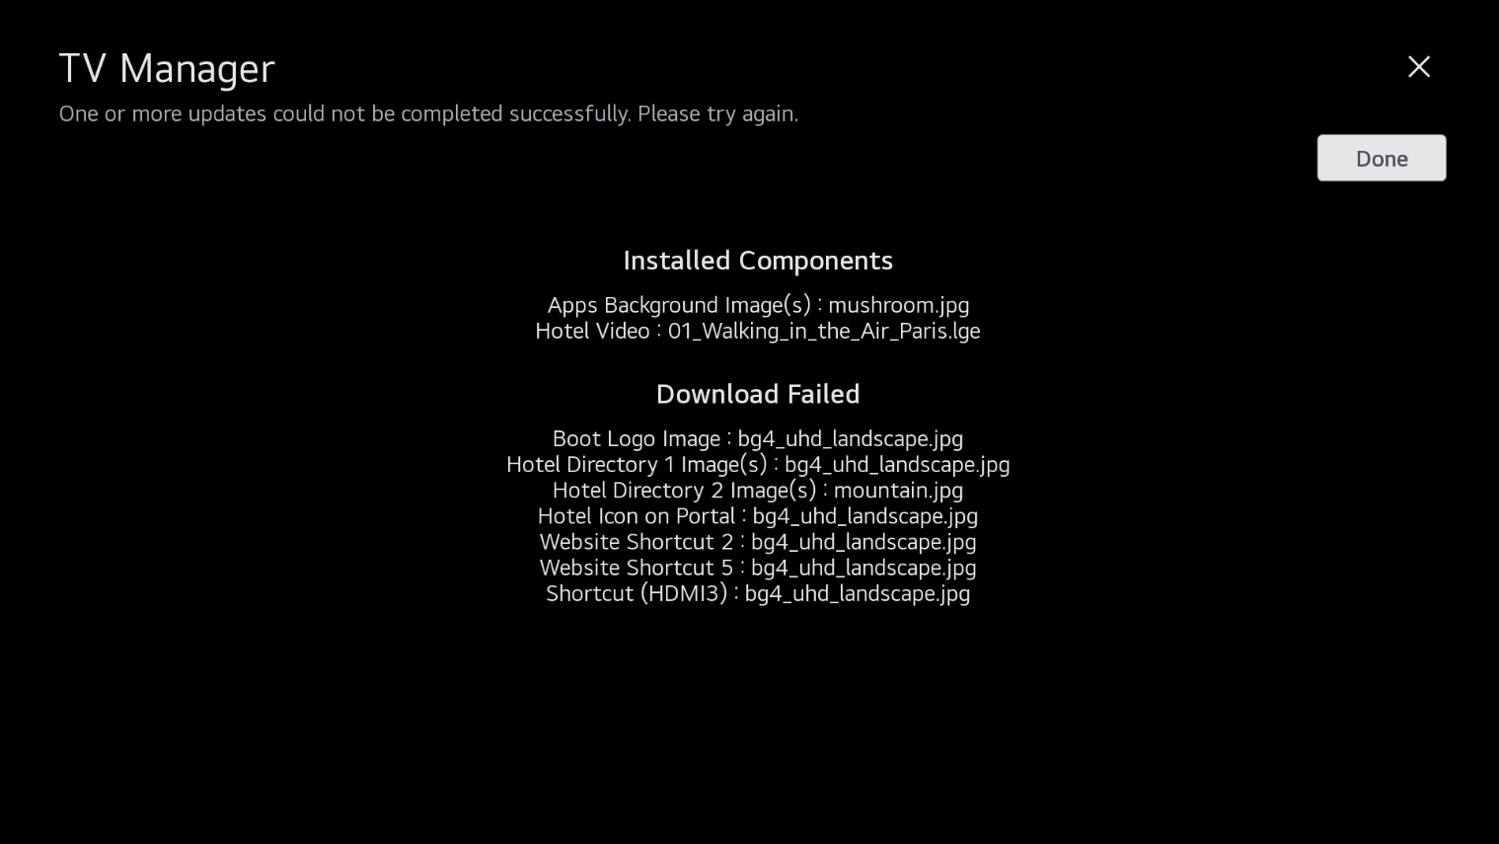
1. UI specification (Ez Download – Update Failure after Reboot)
Other remarks
This page shows a list of failed files.
If you do not select Done button, this page remains.(This page does not disappear to time out.)
Button
Operation
1. Done Button: When you press OK (Enter) on the remote, panel is changed to Ez Download initial screen.
Further
Operation
This page will be displayed automatically after the TV reboots.
The time-out does not apply in this page.

Slide 20
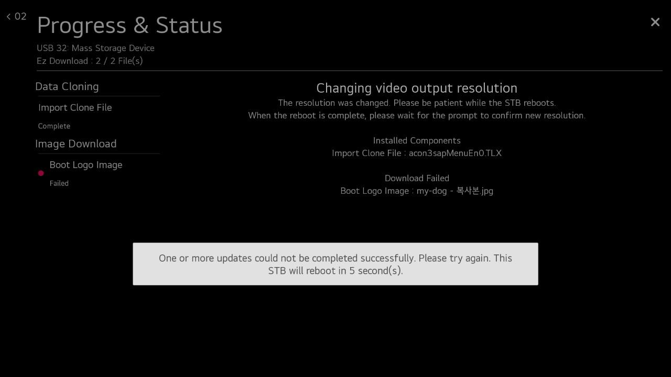
1. UI specification (Ez Download – Download/Update Successful/Complete(STB Only))
Other remarks
There is no STB model at this time.
Additional message :
“Changing video output resolution
The resolution was changed. Please be patient while the STB reboots.
When the reboot is complete, please wait for the prompt to confirm new resolution.
Screen
Explanation
The STB model prints additional message on the main screen when the resolution is changed.
Resolution can be changed through cloning.
Further
Operation

Slide 21
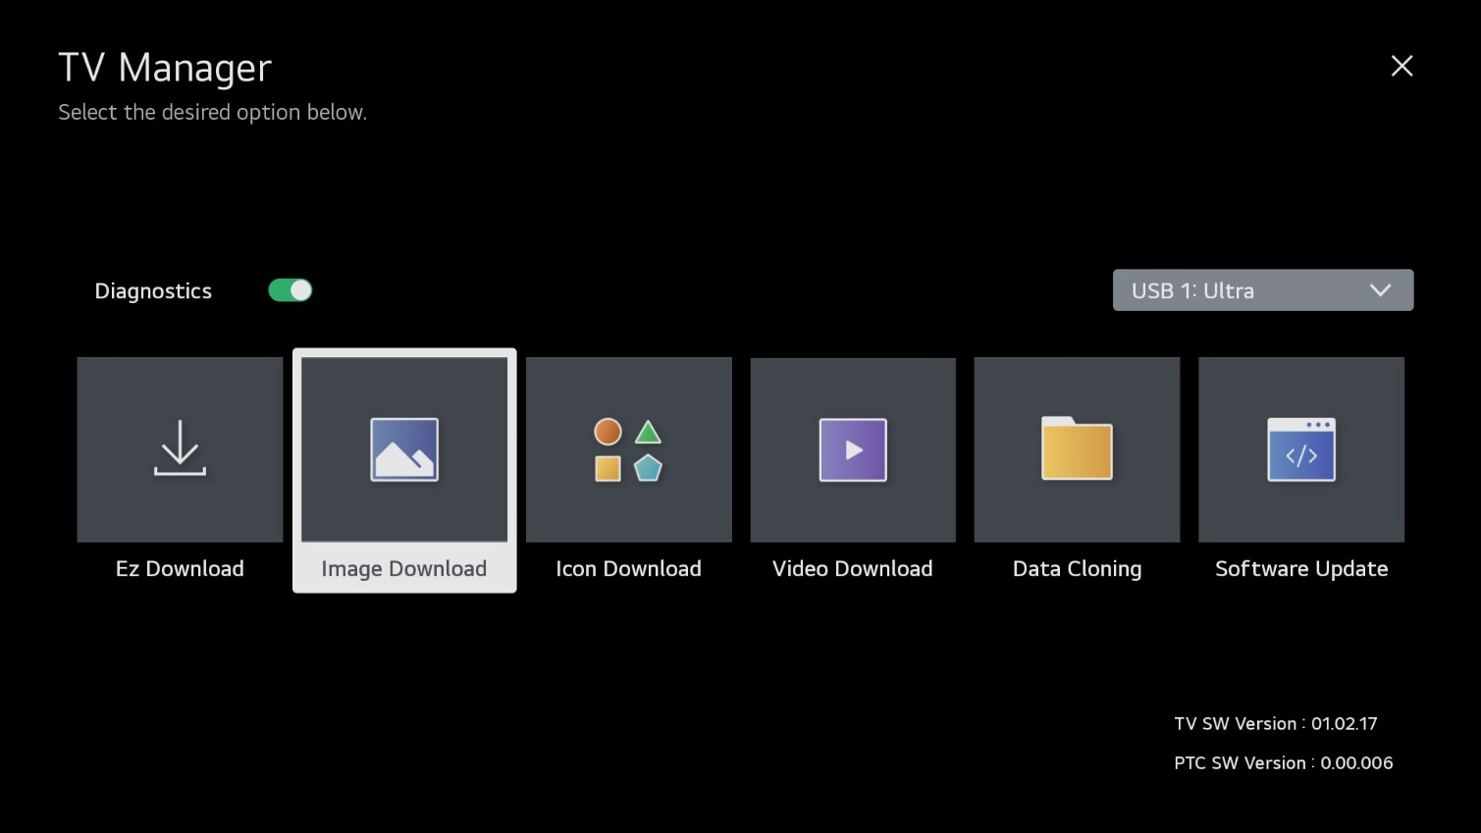
1. UI specification (Image Download - Overview_1)
Other remarks
Screen
Explanation
Image Download contains “Boot Logo Image,” “Apps Background Image(s),” and “Hotel Directory Image(s)” options.
Further
Operation
Image Download downloads “Boot Logo Image,” “Apps Background Image(s),” and “Hotel Directory Image(s)” at once.
If you download an image from “Image Download,” the TV does not reboot even though the download ends differently from Ez Download (i.e., the TV will reboot after image downloads performed in the Ez Download utility).

Slide 22
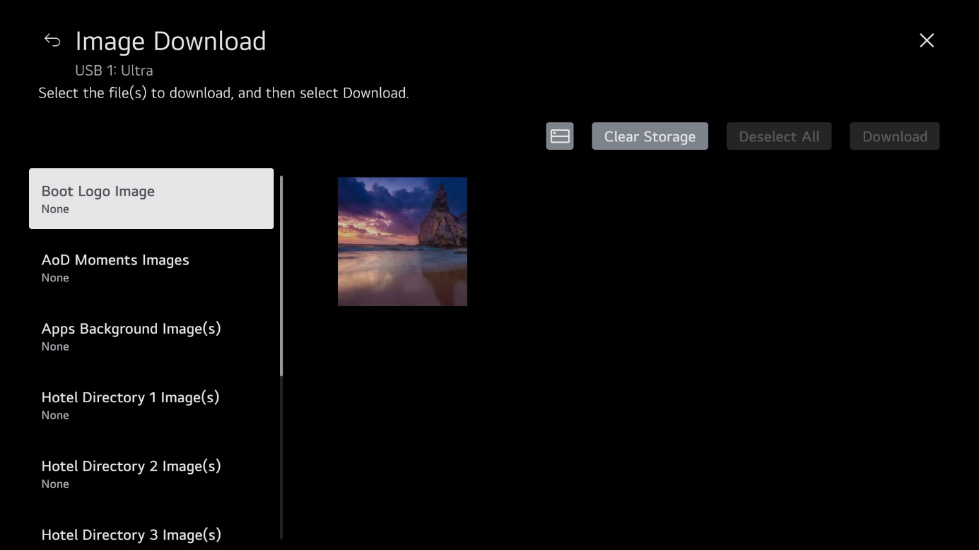
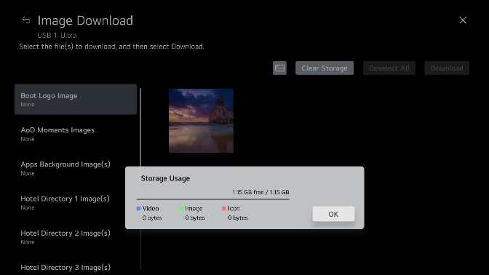
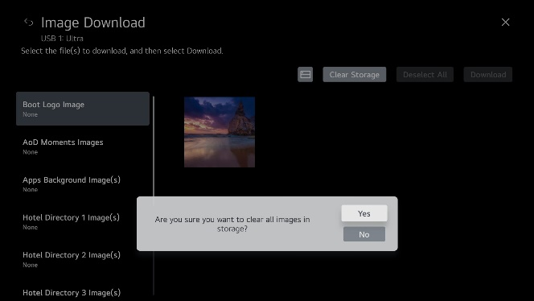

1. UI specification (Image Download - Overview_2)
Other remarks
Button
Operation
Download: Start the download. The download sequence is Select Image Download option/type -> Select Image(s) -> Download.
Deselect All: Returns to the previous state of selection.
: Shows the capacity of the downloaded media files and the available capacity.
Clear Storage: Delete all image files.
If user is in the Ez Download utility and selects Clear Storage, all media files will be cleared, but if user is in an individual category, only that category’s files will be cleared.
Further
Operation

Slide 23
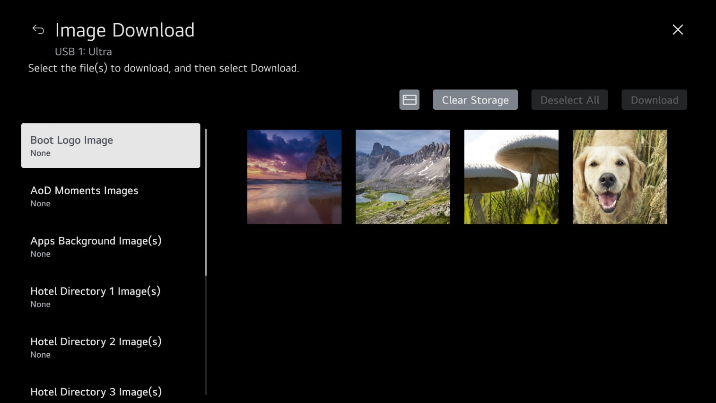
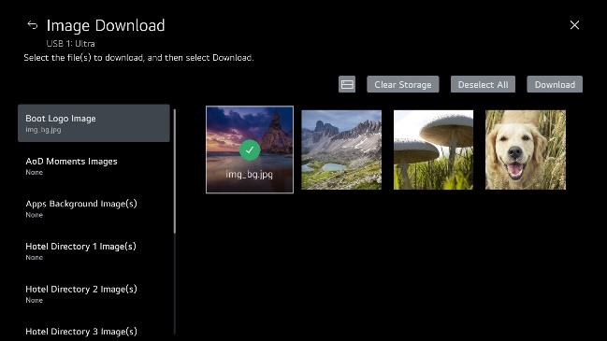
1. UI specification (Image Download - Boot Logo Image)
Other remarks
When you select image, image is checked.
If there are no logo (i.e., splash screen) image files, the screen will show: “No media files on selected USB device.”
Logo image update function supports only JPG, JPEG (up to 6 MB per image) or BMP (up to 5.93 MB per image) format file.
TV keeps splash image until you download a new splash image.
Max resolution of splash image: Full HD → 1920 x 1080, HD → 1360 x 768 (typical - this may vary by TV).
Min resolution of splash image: Full 64 x 64.
OLED Model does not support
Screen
Explanation
1. Image area: Show images in USB device \LG_DTV or \lg_dtv folder. User can select the desired image to use for the splash screen when the TV is turned on.
Default focus: Boot Logo Image
Further
Operation
Right Key: Move to image area.
Down Key: Move to “Apps Background Image(s).”
3. Image area: Use the arrow keys to navigate between images. Press OK (Enter) on the remote to select an image.

Slide 24
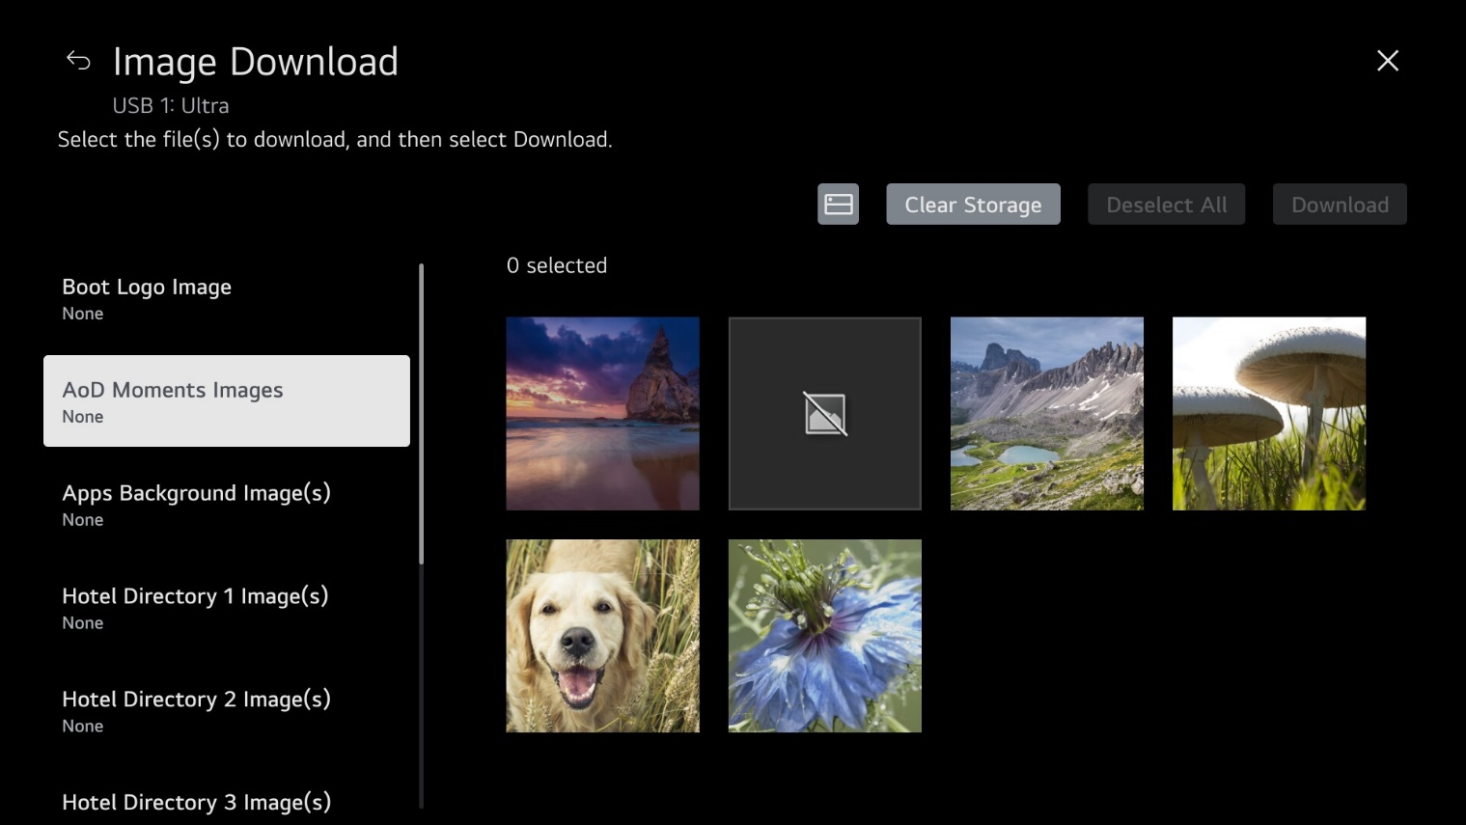
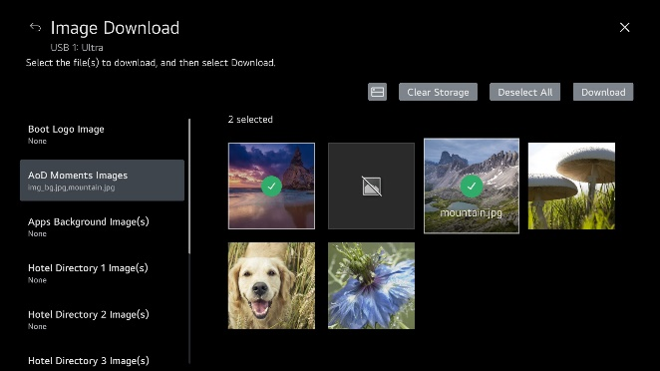
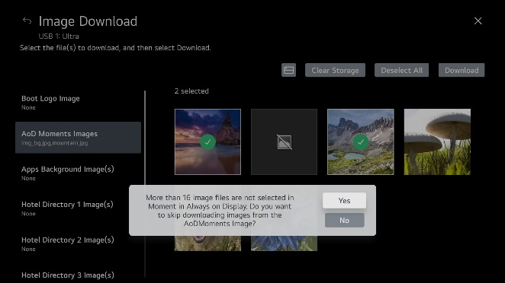
1. UI specification (Image Download – AOD Moments Image)
Other remarks
1. When selecting an image, indicate the number of selected files at the top.
2. There is no maximum number of images that can be selected. It can only be downloaded within 100MB.
3. If you start downloading without selecting more than 16 items, it will display a warning pop-up.
Screen
Explanation
AOD update function supports only JPG, JPEG, PNG format file of less than 100 MB file size.
If you update the images, original images will be removed.
AOD is only available in OLED models, and Instant On should also be supported.
At least 16 images must be selected.
Further
Operation
Right Key: Move to image area.
Up/Down Key: Move to “Boot Logo Image” or “Hotel Directory x Image(s).”
3. Image area: Use the arrow keys to navigate between images. Press OK (Enter) on the remote to select an image.

Slide 25


1. UI specification (Image Download – Apps Background Image(s))
Other remarks
When you select image, image is checked.
If there are no background image files, the screen will show: “No media files on selected USB device.”
Background Image update function supports only JPG, JPEG, PNG format file of less than 10 MB file size.
Max resolution of background image: UHD → 3840 x 2160, Full HD → 1920 x 1080, HD → 1360 x 768 (typical - this may vary by TV).
Min resolution of background image: 64 x 64.
If you update the images, original images will be removed.
OLED Model does not support
Screen
Explanation
Image area: Show images in USB device \LG_DTV or \lg_dtv folder. User can select up to 12 images to use for background images. These images will be displayed as a slide show if the user selects this option while using the TV’s Bluetooth Sound Sync feature, audio only channels, or clock.
Right Key: Move to image area.
Up/Down Key: Move to “Boot Logo Image” or “Hotel Directory x Image(s).”
3. Image area: Use the arrow keys to navigate between images. Press OK (Enter) on the remote to select an image. Maximum number of images that can be updated at once is 12 (or up to 10 MB).
Further
Operation

Slide 26


1. UI specification (Image Download – Hotel Directory Image(s))
Other remarks
When you select image, image is checked.
If there are no background image files, the screen will show: “No media files on selected USB device.”
Hotel Directory Image update function supports only JPG, JPEG, PNG format file of less than 10 MB file size.
Max resolution of background image: UHD → 3840 x 2160, Full HD → 1920 x 1080, HD → 1360 x 768 (typical - this may vary by TV).
Min resolution of image: 64 x 64.
If you want to use Hotel Directory Image(s) in Hotel Directory App, set the image during installation (IP Environment Menu → Portal Settings → Portal Mode “Customizable Portal” → Hotel Directory).
If you update the images, original images will be removed.
Screen
Explanation
Image area: Show images in USB device \LG_DTV or \lg_dtv folder. User can select up to 12 images to use for Hotel Directory Images. These images will be displayed as a slide show in Hotel Directory App.
Further
Operation
Right Key: Move to image area.
2. Image area: Use the arrow keys to navigate between images. Press OK (Enter) on the remote to select an image. Maximum number of images that can be updated at once is 12 (or up to 10 MB).

Slide 27



1. UI specification (Image Download Complete/Fail)
Other remarks
If the image fails to download, the update status is displayed as Failed.
Button
Operation
1. OK Button: If show a popup , image download is complete. Check the update status. When you select OK (press OK [Enter] on the remote), panel is changed to Image Download screen.
If the image is successful for downloading, the update status is displayed as Complete.
Further
Operation
If the download was completed, the screen maintains the last update status and the pop-up appears.
When the download is complete, the TV will not reboot.
The time-out does not apply in complete page.

Slide 28

1. UI specification (Icon Download – Overview_1)
Other remarks
Screen
Explanation
Icon Download contains “Hotel Icon on Portal,” “Website Shortcut,” and “Input Shortcut.”
Further
Operation
Icon Download downloads “Hotel Icon on Portal,” “Website Shortcut,” and “Input Shortcut” images at once.
If you download an icon image from “Icon Download,” the TV does not reboot even though the download ends differently from “Ez Download” (i.e., the TV will reboot after icon downloads performed in the Ez Download utility).

Slide 29



1. UI specification (Icon Download – Overview_2)
Other remarks
Button
Operation
Download: Start the download. The download sequence is Select Icon Download option/type -> Select Icon -> Download.
Deselect All: Returns to the previous state of selection.
: Shows the capacity of the downloaded media files and the available capacity.
Clear Storage: Delete all image (icon) files.
If user is in the Ez Download utility and selects Clear Storage, all media files will be cleared, but if user is in an individual category, only that category’s files will be cleared.
Further
Operation

Slide 30

1. UI specification (Icon Download – Hotel Icon on Portal/Website Shortcut/Input Shortcut)
Other remarks
When you select image, image is checked.
If there are no icon image files, the screen will show: “No media files on selected USB device.”
Icon Image update function supports only JPG, JPEG, PNG format file of less than 10 MB file size.
Max resolution of background image: UHD → 3840 x 2160, Full HD → 1920 x 1080, HD → 1360 x 768 (typical - this may vary by TV).
Min resolution of image: 64 x 64.
If you update the images, original images will be removed.
Screen
Explanation
Image area: Show images in USB device \LG_DTV or \lg_dtv folder. User can select only one image to use as icon.
Default focus: Hotel Icon on Portal
Further
Operation
1. Right Key: Move to image area.
2. Image area: Use the arrow keys to navigate between images. Press OK (Enter) on the remote to select an image.

Slide 31



1. UI specification (Icon Download Complete/Fail)
Other remarks
If the image fails to download, the update status is displayed as Failed.
Button
Operation
1. OK Button: If show a popup , icon download is complete. Check the update status. When you select OK (press OK [Enter] on the remote), panel is changed to icon image Download screen.
If the image is successful for downloading, the update status is displayed as Complete.
Further
Operation
1. If the download was completed, the screen maintains the last update status and the pop-up appears.
When the download is complete, the TV will not reboot.
The time-out does not apply in complete page.

Slide 32

1. UI specification (Video Download – Overview_1)
Other remarks
Screen
Explanation
Video Download contains “Hotel Video.”
Further
Operation
Video Download downloads “Hotel Video” file.
If you download a video file from “Video Download,” the TV does not reboot even though the download ends differently from “Ez Download” (i.e., the TV will reboot after video downloads performed in the Ez Download utility).

Slide 33



1. UI specification (Video Download – Overview_2)
Other remarks
Button
Operation
Download: Start the download. The download sequence is Select Video Download option/type -> Select Image(s) -> Download.
Deselect All: Returns to the previous state of selection.
: Shows the capacity of the downloaded media files and the available capacity.
Clear Storage: Delete all video files.
If user is in the Ez Download utility and selects Clear Strorage, all media files will be cleared, but if user is in an individual category, only that category’s files will be cleared.
Further
Operation

Slide 34

1. UI specification (Video Download – Hotel Video)
Other remarks
When you select video file, image is checked.
If there are no video files, the screen will show: “No media files on selected USB device.”
Video file update function supports only divx, avi, mkv, mp4, 3gp, 3g2, ts, tp, trp, mpg, mpeg, vob, vro, asf, wmv, mov, dat, f4v, flv, tts, m4v, k3g, m2ts, mpe, mts, webm, lge, lg2, lgv Whether or not the video can be played is determined by the using module.
If you update the video file, original video file will be removed.
Image area: Show thumbnails of videos in USB device \LG_DTV or \lg_dtv folder. User can select only one video in each category.
Default focus: Welcome Video
Screen
Explanation
Further
Operation
1. Right Key: Move to image area.
2. Image area: Use the arrow keys to navigate between video thumbnails. Press OK (Enter) on the remote to select a video.

Slide 35



1. UI specification (Video Download Complete)
Other remarks
If the capacity you want to download is greater than the internal capacity, the pop-up is output.
Button
Operation
1. OK Button: If show a popup , icon download is complete. Check the update status. When you select OK (press OK [Enter] on the remote), panel is changed to Video Download screen.
If the video is successful for downloading, the update status is displayed as Complete.
Further
Operation
1. If the download was completed, the screen maintains the last update status and the pop-up appears.
When the download is complete, the TV will not reboot.
The time-out does not apply in complete page.

Slide 36

1. UI specification (Data Cloning)
Other remarks
Screen
Explanation
Data Cloning contains “Import Clone File” and “Export Clone File” options.
Further
Operation

Slide 37

1. UI specification (Import Clone File)
Other remarks
If it contains an FTG Channel Map, the Clone (.tlx) file configures the TV for FTG Mode via CPU operation.
Users may export (save) FTG configuration from a Master TV, if necessary/desired (see Export Clone File process). Once the internal TV data and its Channel Map information are exported to the USB device, the user can start Import Clone File process with the data (.tlx) file generated and stored on the USB device. As warned in Export Clone File process, the user should not turn TV off or unplug the USB device.
When download is completed, the TV will automatically reboot.
If there are no Clone files, the screen will show: “No Clone files on selected USB device.”
Display Logical or Physical channel tuning selection UI when FTG Channel Map in TLX file includes RF channels and Aux inputs only. Physical channel tuning is not available when the FTG Channel Map includes IP channels.
If file has no FTG Channel Map, “No Channel Map in Clone file!!” is displayed. When there is no FTG Channel Map in TLX file, then NO mode changes.
For “Restore_Pass-through_Mode”.tlx file, “Zero Mapped Channels in Clone file Channel Map!!” is displayed.
Button
Operation
Files: Show “.tlx” files in USB device root folder. User can select the appropriate Clone file to configure the TV for FTG Mode via CPU.
Update Button: Select to initiate the update. The download sequence is Import Clone File -> Select file (TLX) -> Update.
1. Right Key: Move to file area.
File area: Use the Up/Down arrow keys to navigate the list of files. Press OK (Enter) on the remote to select a file. If a .tlx file has an FTG Channel Map with RF channels and Aux inputs only, a Channel Tuning / Channel Banner Display field will be displayed on the right side of the screen, and you can select Logical or Physical channel tuning. Use the arrow keys to move to this field/select the desired option.
Further
Operation

Slide 38



1. UI specification (Import Clone File Complete/Fail)
Other remarks
Fail pop-up message:
“Import Clone File has failed. Please try again.”
Button
Operation
1. OK Button: If this button is displayed in the pop-up window, the update failed. Check the update status. When you press OK (Enter) on the remote, panel is changed to Import Clone File screen.
Complete pop-up message:
“Import Clone File is completed. TV will reboot in 5 seconds.”
1. If the download was completed successfully, the “Import Clone File is completed” pop-up message will be displayed, and then the TV will reboot.
If the download failed, the “Import Clone File has failed” pop-up message will be displayed, and the TV will not reboot.
The time-out does not apply when a failed pop-up is output.
Further
Operation

Slide 39

1. UI specification (Import Clone File Complete(STB Only))
Other remarks
There is no STB model at this time.
Complete pop-up message:
“The resolution was changed. Please be patient while the STB reboots.
When the reboot is complete, please wait for the prompt to confirm new resolution.”
Button
Operation
1. The STB model changes the message of the complete pop-up when the resolution changes.
Further
Operation

Slide 40

1. UI specification (Export Clone File)
Other remarks
1. The Export Clone File option enables users to save a “.tlx” Clone file to a USB device. The exported Clone file can then be transferred to Target TVs using the Import Clone File process. While the export is in process, the user must not turn TV off or unplug the USB memory device.
2. In addition to the FTG Channel Map and Installer Menu settings, an exported Clone file includes setup menu settings. Users may customize selected setup menu settings as indicated in appropriate Commercial Mode Setup Guide.
3. If the exported Clone file does not include an FTG Channel Map (i.e., no existing channel lineup prior to export), any Target TVs to which the file is imported will not be configured for FTG Mode via CPU.
Button
Operation
1. Export Button: Select to initiate the export. When you press OK on rolling picker, Export button is activated.
When model name have TV size, generic “xx” will be displayed before the model name, for example, xxUR670H.
Further
Operation
1. Right Key: Move to rolling picker.
Up Key: Move to “Import Clone File.”
Rolling picker: Use the Left/Right arrow keys to choose the Clone filename (“modelname”_1~99999.TLX).

Slide 41




1. UI specification (Export Clone File Complete/Fail)
Other remarks
Fail pop-up message:
“Export Clone File has failed. Please try again.”
Same filename pop-up message :
“The filename “” already exists. Do you want to overwrite it?”
Button
Operation
1. OK Button: If this button is displayed in the pop-up banner, the export ended. Check the status, as the pop-up message will either indicate that the export was successful or not successful. When you press OK (Enter) on the remote, panel is changed to Export Clone File screen.
2. Yes Button: This button and the NO button are displayed in the “The filename ‘’ already exists” pop-up message. Select if you would like to overwrite the existing file on the USB device.
3. No Button: Select to return to Export Clone File screen without overwriting the existing file.
Further
Operation
1. The time-out does not apply when a pop-up is output in complete page.
Complete pop-up message :
“Export Clone File is completed.”

Slide 42


1. UI specification (Export Clone File Complete - Create DZM (Hospital Only))
Other remarks
If you go to Ez Download after Export, the Export file that you just performed is selected.
Further
Operation
If the Export Clone File is successful at the hospital, the DZM file is automatically created.
DZM file in this case will maintain history of only the Clone file.

Slide 43

1. UI specification (Update TV Software)
Other remarks
Screen
Explanation
Software Update contains “Update TV Software” and “Update PTC Software.”
Further
Operation
Only one software update can be performed at a time.

Slide 44


1. UI specification (Update TV Software)
Other remarks
Selected file is highlighted.
When download is completed, the TV will automatically reboot.
If there are no TV software files, the screen will show: “No TV software files on selected USB device.”
Current TV software version is displayed above list of files.
1. Files: Show “.epk” files in USB device \LG_DTV or \lg_dtv folder. User can select the appropriate file to update the TV CPU software.
Update Button: The button is only active when the file is selected. Select to initiate the update.
The download sequence is Update TV Software -> Select file (EPK) -> Update.
Button
Operation
Further
Operation
1. Right Key: Move to file area.
Up/Down Key: Move to “Update” or ⓧ.
Down Key: Move to “Update PTC Software.”
File area: Use the Up/Down arrow keys to navigate the list of files. Press OK (Enter) on the remote to select a file.

Slide 45



1. UI specification (Update TV Software Complete/Fail)
Other remarks
Fail pop-up message:
“TV Software update has failed. Please try again.”
Button
Operation
1. OK Button: If this button is displayed in the pop-up window, the update failed. Check the update status. When you press OK (Enter) on the remote, panel is changed to Update TV Software screen.
Complete pop-up message:
“TV Software update is completed. TV will reboot in 5 seconds.”
Further
Operation
1. If the download was completed successfully, the “TV Software update is completed” pop-up message will be displayed, and then the TV will reboot.
If the download failed, the “TV Software update has failed” pop-up message will be displayed, and the TV will not reboot.
The time-out does not apply when a failed pop-up is output.

Slide 46


1. UI specification (Update TV Software with PTC Update)
Other remarks
Further
Operation
If the PTC Micom version is lower than the version included in the EPK, update the PTC Micom when updating the EPK. This is an existing function. However, from webOS23, it was added to indicate that it is being updated if PTC Micom is also updated when only EPK is updated.

Slide 47


1. UI specification (Update PTC Software)
Other remarks
Selected file is highlighted.
When download is completed, the TV will automatically reboot.
If there are no PTC software files, the screen will show: “No PTC software files on selected USB device.”
Current PTC software version is displayed above list of files.
1. Files: Show “.txt” files in USB device \LG_DTV or \lg_dtv folder. User can select the appropriate file to update the PTC software.
The download sequence is Update PTC Software -> Select file (PTC) -> Update.
Update Button: The button is only active when the file is selected. Select to initiate the update.
Button
Operation
Further
Operation
1. Right Key: Move to file area.
Up Key: Move to “Update TV Software.”
File area: Use the Up/Down arrow keys to navigate the list of files. Press OK (Enter) on the remote to select a file.

Slide 48




1. UI specification (Update PTC Software Complete/Fail)
Other remarks
Fail pop-up message:
“PTC Software update has failed. TV will reboot in 5 second(s).”
Button
Operation
1. If the download was completed successfully, the “PTC Software update is completed” pop-up message will be displayed, and then the TV will reboot.
2. If the download failed, the “PTC Software update has failed” pop-up message will be displayed, and then TV will reboot. See next page for screen that will be displayed after reboot.
Complete pop-up message:
“PTC Software update is completed. TV will reboot in 5 second(s).”
Further
Operation

Slide 49

1. UI specification (Update PTC Software Failure after Reboot)
Other remarks
Button
Operation
1. Done Button: After the TV reboots following a PTC update failure, this button is displayed in the failure page. Check the update status. When you press OK (Enter) on the remote, panel is changed to Update PTC Software screen.
Further
Operation
This page will be displayed automatically after the TV reboots.
The time-out does not apply in this page.

